Slide 1
Course Introduction
Welcome to ENGL 3110

Slide 2
Unit Two
I don’t think we are ready for the exam.
Exam pushed back one class day.
  No Homework - Wednesday 10/15
  Exam Study Guide - Monday 10/20
  Exam Two – Wednesday 10/22
Application Paper and Exam Three pushed back one week each
Exam Four still last regular day of class (no class on finals week)

Slide 3
Unit Two
Wellness Check-In
Have a Conversation with 3-4 of your Peers
  What is going well this semester in school/life?
  What is going poorly this semester in school/life?
  What are you doing to take care of yourself/improve your overall wellness?
  What could you begin doing/stop doing/change to take care of yourself more?
Share one take-away with the class

Slide 4
Unit Two
Sentence Patterns
  Identify, label, diagram, and create
Coordination and Subordination
  Identify, edit, diagram, and create
    Simple, Compound, and Complex Sentences
    Coordinating Conjunctions and Subordinating Conjunctions
    Conjunctive Adverbs and Connecting Phrases
    Coordinated Phrases

Slide 5
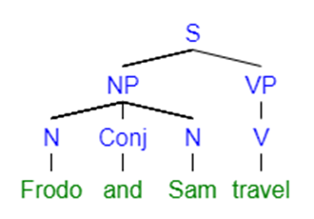
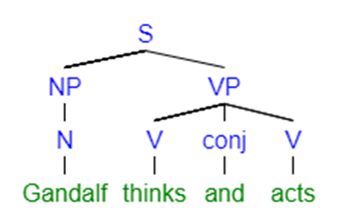
Two Phrases with a Conjunction

Slide 6
Review
Punctuation for PHRASES
  No comma needed for two phrases of any kind
    Bob and Jim run.
    Bob ,Jim run and jump.
    Bob and Jim throw balls and frisbees but chase cars and ducks.
    Bob and Jim throw balls and frisbees but chase cars and ducks on Sundays and on holidays.
    Bob and Jim throw balls and frisbees but chase cars and ducks on Sundays and Mondays and on holidays.

Slide 7
Review
Punctuation for PHRASES
  Needs a comma when you have THREE Phrases (a list)
    Bob, Jim, and Pam run.
    Bob and Jim run, jump, and skip.
    Bob throws balls, frisbees, and javelins.
    Bob throws balls, drive cars, and chase ducks.
    Bob chases ducks on Sundays, Mondays, and holidays.

Slide 8
Review
Punctuation for CLAUSES
  These rules change dramatically when you have clauses
    Clauses are “sets” of subjects and verbs.
    Clauses have a new “S” at the top.
    Clauses for declarative sentences always have at least one subject and at least one verb.
  Two Phrases:
    Bob and Jim run and skip.
  Two clauses
    Bob runs, and Jim skips.

Slide 9
Two Phrases with a Conjunction

Slide 10
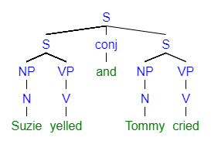
Two Clauses with a Coordinating Conjunction

Slide 11
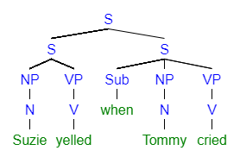
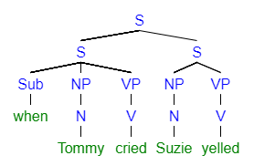
Two Clauses with a Subordinating Conjunction

Slide 12
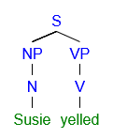
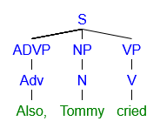
Two Clauses with a Conjunctive Adverb

Slide 13
Review
Sentence Connectors
    Coordinating Conjunctions (FANBOYS)
      I like ice cream, and I like cake.
    Subordinating Conjunctions (pass the flip test)
      I like ice cream when I eat cake.
      When I eat cake, I like ice cream.
    Conjunctive Adverbs (However, Also)
      I like ice cream. Also, I like cake.

Slide 14
Sentence Types
Compound Sentence
  Coordinating Conjunctions (FANBOYS)
    I like ice cream, and I like cake.
Complex Sentence
  Subordinating Conjunctions (pass the flip test)
    I like ice cream when I eat cake.
    When I eat cake, I like ice cream.
Two Simple Sentences
  Conjunctive Adverbs (However, Also)
    I like ice cream. Also, I like cake.

Slide 15
Coordination and Subordination
Review Handout
Compare Homework with a Partner and Discuss
  Aim to work with someone new
Discuss Homework Answers

Slide 16
End of Class
If you have questions or concerns, hang around to talk.

